Slide 1
Risk stratification and medical management of STEMI Dr Saidalavi 17-5-12

Slide 2
OUTLINE
Definition of MI
Risk stratification
Medical management

Slide 3
Criteria for Diagnosis
New ST elevation at the J point in two anatomically contiguous leads using the following diagnostic thresholds:
≥0.1 mV (1 mm) in all leads other than V2-V3, where the following diagnostic thresholds apply:
≥0.2 mV (2 mm) in men ≥ 40 years;
≥0.25 mV (2.5 mm) in men <40 years,
or ≥0.15 mV (1.5 mm) in women

Slide 4
Universal definition MI
Universal definition of myocardial infarction. J Am Coll Cardiol 60:1581, 2012.
Criteria for Acute, Evolving, or Recent MI
Either of the following criteria satisfies
Typical rise &/or fall of biochemical markers of myocardial necrosis with at least one of the following:
Ischemic symptoms
ECG changes indicative of new ischemia (new ST elevation or new/presumed to be new LBBB)
Development of pathological Q waves in the ECG
Imaging e/o new loss of viable myocardium or new RWMA
Pathologic findings of an acute MI -Identification of an intracoronary thrombus by angiography or autopsy

Slide 5
Universal definition MI
Universal definition of myocardial infarction. J Am Coll Cardiol 60:1581, 2012.
PCI periprocedural MI:
increases of biomarkers >5 x 99th percentile URL
CABG-related MI
Increases of biomarkers > 10 x 99th percentile URL plus either new pathological Q waves or new LBBB, or angiographically documented new graft or native coronary artery occlusion, or imaging evidence of new loss of viable myocardium.

Slide 6
Risk stratification of STEMI

Slide 7
Risk stratification is defined as “a statistical process to determine detectable characteristics associated with an increased chance of experiencing unwanted outcomes.
Despite progress in pre-hospital care, ambulance logistics, pharmacotherapy and PPCI techniques, STEMI continues to confer a substantial burden of morbidity and mortality and consumes significant healthcare budget.
When compared to the NSTEMI population there has been little effort to quantify patient risk in STEMI since all randomized controlled trials studying PPCI efficacy offer PPCI as default.
In contemporary practice it is, unlikely that a STEMI risk score would impact on decision making, since the pathway is algorithmic once a diagnosis is made.
Risk scoring is therefore only used to evaluate hospital and individual operator performance.

Slide 8
Risk Stratification
Occurs in several stages
Initial presentation
In-hospital course (CCU, intermediate CU)
At the time of hospital discharge

Slide 9
Acute Phase Risk Stratification: Electrocardiographic features
Anterior MI/ Persisting ST elevation
Q waves in multiple leads
RVMI + IWMI
High sum of ST elevation
Reciprocal ( anterior ) ST depression
Persisting ST depression
Prolonged QT
Conduction defects/ heart block
Sinus tachycardia/ atrial fibrillation
Notes:
Prior angina pectoris
Prior MI
Female gender
Hypertension
History of CHF
Hyperlipidemia
Diabetes
ECG Criteria
Markedly elevated cardiac enzymes
Elevated BUN
Complications
VSR/PMD-rupture
Myocardial rupture

Slide 10
Acute Phase Risk Stratification: Importance of LV dysfunction
(Killip T, and Kimball JT: Treatment of myocardial infarction in a coronary care unit: a two year experience of 250 patients. American Journal of Cardiology 1967; 20: 457-464 )
Left ventricular dysfunction is the single most important predictor of mortality

Slide 11
Risk Scores
TIMI
GRACE
Zwolle primary PCI index
CADILLAC risk score
Goldman
PURSUIT
best used to supplement—not replace—clinical judgment

Slide 12
TIMI 30-day MORTALITY
(David A et al. TIMI Risk Score for ………..: An Intravenous nPA for Treatment of Infarcting Myocardium Early II Trial Substudy. Circulation 2000, 102:2031-2037)

Slide 13
TIMI 1yr MORTALITY (30-day survivors)
(David A et al. TIMI Risk Score for ………..: An Intravenous nPA for Treatment of Infarcting Myocardium Early II Trial Substudy. Circulation 2000, 102:2031-2037)

Slide 14
The Thrombolysis In Myocardial Infarction (TIMI) risk index (TRI)
( Wiviott SD et al Performance of the TRI in the National Registry of Myocardial Infarction-3 and -4:. J Am Coll Cardiol 2004;44:783–9 )
Derived from In TIME II trial & validated in TIMI-9 trials
Based on age and vital signs, in predicting mortality among a large, community based, unselected, heterogeneous population
Heart rate * [age/10 ]² /systolic blood pressure
A strong and independent predictor of mortality at 24 h and at 30 days (p 0.0001)

Slide 15
TIMI risk index and mortality ( Stephen D et al. Application of the Thrombolysis In Myocardial Infarction Risk Index in Non–ST-Segment Elevation Myocardial Infarction Evaluation of Patients in the National Registry of Myocardial Infarction, JAAC: Vol. 47, No. 8, 2006)

Slide 16
GRACE RISK SCORE
Can be used to predict the cumulative risk of death and death or myocardial infarction in the period from admission to hospital to six months after discharge
The tool is simple and applicable to patients across the complete spectrum of acute coronary syndrome

Slide 17
Consists of 8 independent risk factors
● Age
● Killip class
● Systolic blood pressure
● Presence of ST segment deviation
● Cardiac arrest during presentation
● Serum creatinine concentration
● Presence of elevated serum cardiac biomarkers
● Heart rate
Point scores are assigned for each predictive factor and are added together to arrive at an estimate of the risk of in-hospital mortality.
A normogram was published with the GRACE risk model to allow calculation of risk score
It is also available as an app

Slide 19
Cadillac risk score
Patients are stratified into three risk groups that predict 30-day and one-year mortality:
Low risk: (score 0 to 2) – 0.1 to 0.2% at 30 days and 0.8 to 0.9% at one year
Intermediate risk (score 3 to 5) – 1.3 to 1.9%at 30 days and 4.0 to 4.5% at one year
High risk (score ≥6) – 6.6 to 8.1% at 30 days and 12.4 to 13.2% at one year
Notes:
CADILLAC Controlled Abciximab and Device Investigation to Lower Late Angioplasty Complications trial
The CADILLAC^{[45]} score was developed to predict 30-day and 1-year mortality following primary PCI.
Study limitations included the exclusion of high-risk patients with recent stroke, known renal dysfunction, cardiogenic shock, complex coronary anatomy and those undergoing rescue PCI.

Slide 20
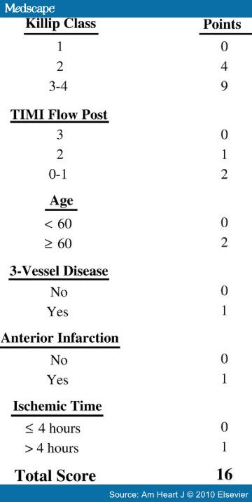
Zwolle primary PCI index
The Zwolle index generates a risk score, on a scale of 0 to 16, that is calculated after the patient has undergone a PCI procedure
Score 0 to 3: Low risk & can be discharged
Score 4 or more: Are considered as high-risk category
Notes:
The Zwolle primary percutaneous coronary intervention (PCI) index is an externally validated risk score that has been used to identify low-risk primary PCI patients who can safely be discharged from the hospital within 48 h to 72 h.
The authors of the Zwolle paper argue that in the absence of contraindications, these low-risk patients (Zwolle score of 3 or lower; Table 1) can safely be discharged from the hospital after 48 h to 72 h.

Slide 21
MEDICAL MANAGEMENT

Slide 22
2013 ACC/AHA Guideline for the Management of ST-Elevation Myocardial Infarction. 2015 ACC/AHA/SCAI Focused Update on Primary PCI for Patients with STEMI. 2016 ACC/AHA Guideline Focused Update on Duration of Dual Antiplatelet Therapy in Patients With Coronary Artery Disease
Notes:
© American College of Cardiology Foundation, American Heart Association, and Society for Cardiovascular Angiography and Interventions
Terms “facilitated PCI” and “rescue PCI” no longer used for the recommendations in this update

Slide 23
Options for Transport of Patients With STEMI and Initial Reperfusion Treatment
Hospital fibrinolysis:
Door-to-Needle
within 30 min.
Not PCI
capable
Onset of symptoms of STEMI
EMS
Dispatch
EMS on-scene
Encourage 12-lead ECGs.
Consider prehospital fibrinolytic if capable and EMS-to-needle within 30 min.
EMS Triage Plan
Inter-Hospital
Transfer
PCI
capable
GOALS
5
min.
8
min.
EMS Transport
Patient
EMS
Prehospital fibrinolysis
EMS-to-needle
within 30 min.
EMS transport
EMS-to-balloon within 90 min.
Patient self-transport
Hospital door-to-balloon
within 90 min.
Dispatch
1 min.
Golden Hour = first 60 min.
Total ischemic time: within 120 min.

Slide 24
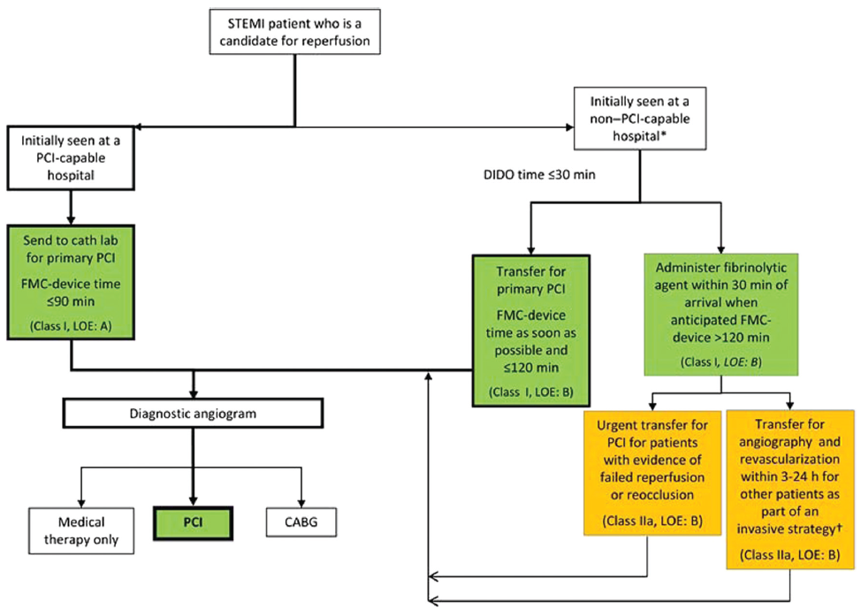
Reperfusion Therapy for Patients with STEMI
*Patients with cardiogenic shock or severe heart failure initially seen at a non–PCI-capable hospital should be transferred for cardiac catheterization and revascularization as soon as possible, irrespective of time delay from MI onset (Class I, LOE: B). †Angiography and revascularization should not be performed within the first 2 to 3 hours after administration of fibrinolytic therapy.

Slide 25
Invasive strategy preferred
Skilled PCI laboratory is available with surgical backup
Medical contact-to-balloon or door-to-balloon less than 90 min
High risk from STEMI
Cardiogenic shock
Killip class ≥ 3
Contraindications to fibrinolysis
Late presentation (> 3 hr)
Diagnosis of STEMI is in doubt

Slide 26
Fibrinolysis preferred
Early presentation (≤3 hr from symptom onset and delay to invasive strategy)
Invasive strategy is not an option
Catheterization laboratory occupied or not available
Vascular access difficulties
Lack of access to a skilled PCI laboratory
Delay to invasive strategy
Prolonged transport
(Door-to-balloon)–(door-to-needle) more than 1 hr
Medical contact-to-balloon or door-to-balloon more than 90 min

Slide 27
Control of cardiac pain
Pain contribute to the heightened sympathetic activity
Typically accomplished with combination of nitrates, analgesics, oxygen and β-blocker
Nitroglycerin Class I (C)
Nitrates should not be administered to patients with:
systolic pressure < 90 mm Hg or ≥ to 30 mm Hg below baseline
severe bradycardia (< 50 bpm)
tachycardia (> 100 bpm)
suspected RV infarction.
who have received a phosphodiesterase
Notes:
Patients with ongoing ischemic discomfort
0.4 mg every 5 minutes for a total of 3 doses
Intravenous NTG
Ongoing ischemic discomfort that responds to nitrate therapy
control of hypertension
management of pulmonary congestion

Slide 28
Control of cardiac pain
Analgesia
Morphine sulfate (2 to 4 mg intravenously) Class I (C)
NSAIDS Increase risk of cardiovascular events so should be discontinued
[A sub study analysis from the ExTRACT TIMI-25 trial showed increased risk of death, reinfarction, heart failure, or shock among patients on NSAIDs within 7 days of enrollment].
Oxygen
Arterial oxygen desaturation (SaO₂ < 90%) Class I(B)
Uncomplicated STEMI during the first 6 hours Class II(A)

Slide 29
Regional Systems of STEMI Care, Reperfusion Therapy, and Time-to-Treatment Goals
I
IIa
IIb
III
Reperfusion therapy should be administered to all eligible patients with STEMI with symptom onset within the prior 12 hours.
A
I
IIa
IIb
III
Primary PCI is the recommended method of reperfusion when it can be performed in a timely fashion by experienced operators.
A
I
IIa
IIb
III
EMS transport directly to a PCI-capable hospital for primary PCI is the recommended triage strategy for patients with STEMI with an ideal FMC-to-device time system goal of 90 minutes or less.*
B
*The proposed time windows are system goals. For any individual patient, every effort should be made to provide reperfusion therapy as rapidly as possible.

Slide 30
Regional Systems of STEMI Care, Reperfusion Therapy, and Time-to-Treatment Goals
I
IIa
IIb
III
Immediate transfer to a PCI-capable hospital for primary PCI is the recommended triage strategy for patients with STEMI who initially arrive at or are transported to a non–PCI-capable hospital, with an FMC-to-device time system goal of 120 minutes or less.*
B
I
IIa
IIb
III
In the absence of contraindications, fibrinolytic therapy should be administered to patients with STEMI at non–PCI-capable hospitals when the anticipated FMC-to-device time at a PCI-capable hospital exceeds 120 minutes because of unavoidable delays.
B
*The proposed time windows are system goals. For any individual patient, every effort should be made to provide reperfusion therapy as rapidly as possible.

Slide 31
Regional Systems of STEMI Care, Reperfusion Therapy, and Time-to-Treatment Goals
I
IIa
IIb
III
When fibrinolytic therapy is indicated or chosen as the primary reperfusion strategy, it should be administered within 30 minutes of hospital arrival.*
B
I
IIa
IIb
III
Reperfusion therapy is reasonable for patients with STEMI and symptom onset within the prior 12 to 24 hours who have clinical and/or ECG evidence of ongoing ischemia. Primary PCI is the preferred strategy in this population.
B
*The proposed time windows are system goals. For any individual patient, every effort should be made to provide reperfusion therapy as rapidly as possible.

Slide 32
Reperfusion at a PCI-Capable Hospital
Primary PCI in STEMI

Slide 33
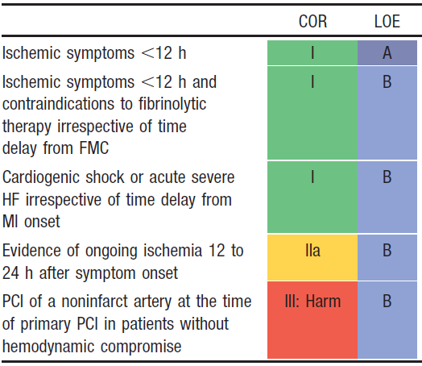
Primary PCI in STEMI

Slide 34
Culprit Artery – Only Versus Multi vessel PCI
COR | LOE | Recommendation
IIb | B-R | PCI of a non infarct artery may be considered in selected patients with STEMI and multi vessel disease who are hemodynamically stable, either at the time of primary PCI or as a planned staged procedure.¹
1. Modified recommendation from 2013 Guideline (changed class from III: Harm to IIb and expanded time frame in which multivessel PCI could be performed).
Notes:
Four RCTs (PRAMI, CvLPRIT, DANAMI 3 PRIMULTI, PRAGUE-13) have since suggested that a strategy of multivessel PCI, either at the time of primary PCI or as a planned, staged procedure, may be safe and beneficial in selected patients with STEMI.
On the basis of these findings, the prior Class III-harm recommendation with regard to multivessel primary PCI in hemodynamically stable patients with STEMI has been upgraded and modified to a Class IIb recommendation to include consideration of multivessel PCI, either at the time of primary PCI or as a planned, staged procedure.
The writing committee emphasizes that this change should not be interpreted as endorsing the routine performance of multivessel PCI in all patients with STEMI and multivessel disease. Rather, when considering the indications for and timing of multivessel PCI, physicians should integrate clinical data, lesion severity/complexity, and risk of contrast nephropathy to determine the optimal strategy.

Slide 35
Aspiration Thrombectomy
I
IIa
IIb
III
Manual aspiration thrombectomy is reasonable for patients undergoing primary PCI.
B

Slide 36
Aspiration Thrombectomy
COR | LOE | Recommendations
IIb | C-LD | The usefulness of selective and bailout aspiration thrombectomy in patients undergoing primary PCI is not well established.¹
III: No Benefit | A | Routine aspiration thrombectomy before primary PCI is not useful.²
1. Modified recommendation from 2013 guideline (Class changed from IIa to IIb for selective and bailout aspiration thrombectomy before PCI)
2. New recommendation
Notes:
The 2011 PCI and 2013 STEMI guidelines’ Class IIa recommendation for aspiration thrombectomy before primary PCI was based on the results of 2 RCTs and 1 meta-analysis and was driven in large measure by the results of TAPAS, a single-center study.
Since formulation of that recommendation, 3 multicenter trials (INFUSE-AMI, TASTE, TOTAL), 2 of which enrolled significantly more patients than prior aspiration thrombectomy trials, have prompted re-evaluation of this recommendation.
These 3 more recent trials, as well as an updated meta-analysis, found no significant reduction in adverse events with routine aspiration thrombectomy.
Based on these 3 trials, routine aspiration thrombectomy before primary PCI is now designated as Class III-No Benefit.
Subgroup analysis in TASTE and TOTAL did not identify any specific subgroup (e.g., anterior MI, high thrombus burden) that benefited from routine aspiration thrombectomy.
Based on these and other considerations, a Class IIb recommendation was established stating that the usefulness of selective and bailout aspiration thrombectomy in patients undergoing primary PCI is not well established

Slide 37
Use of Stents in Patients With STEMI
I
IIa
IIb
III
Placement of a stent (BMS or DES) is useful in primary PCI for patients with STEMI.
A
I
IIa
IIb
III
BMS* should be used in patients with high bleeding risk, inability to comply with 1 year of DAPT, or anticipated invasive or surgical procedures in the next year.
I
IIa
IIb
III
DES should not be used in primary PCI for patients with STEMI who are unable to tolerate or comply with a prolonged course of DAPT because of the increased risk of stent thrombosis with premature discontinuation of one or both agents.
B
Harm
*Balloon angioplasty without stent placement may be used in selected patients.

Slide 38
Reperfusion at a PCI-Capable Hospital
Adjunctive Antithrombotic Therapy for Primary PCI

Slide 39
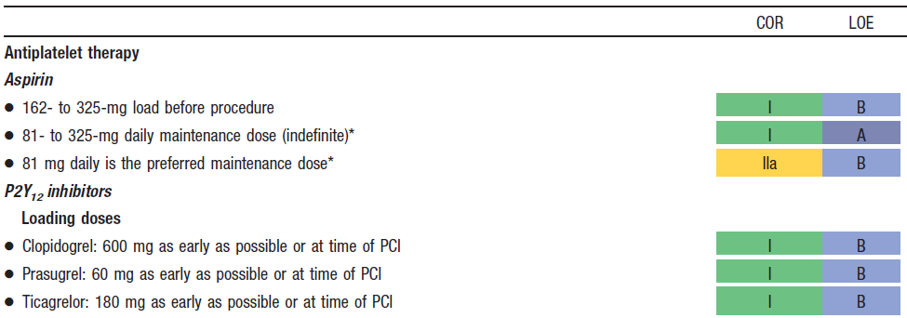
Adjunctive Antithrombotic Therapy to Support Reperfusion With Primary PCI
*The recommended maintenance dose of aspirin to be used with ticagrelor is 81 mg daily.

Slide 40
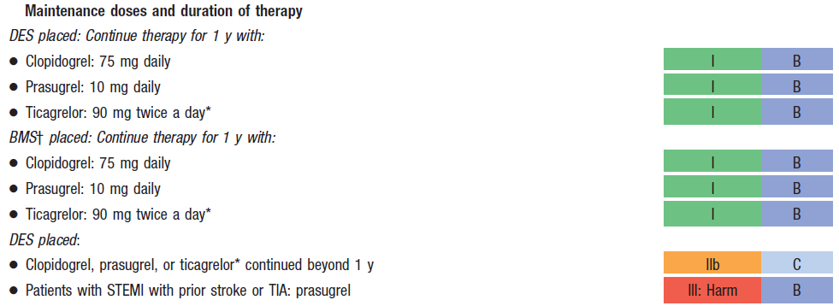
Adjunctive Antithrombotic Therapy to Support Reperfusion With Primary PCI (cont.)
*The recommended maintenance dose of aspirin to be used with ticagrelor is 81 mg daily.
†Balloon angioplasty without stent placement may be used in selected patients. It might be reasonable to provide P2Y₁₂ inhibitor therapy to patients with STEMI undergoing balloon angioplasty alone according to the recommendations listed for BMS. (LOE: C).

Slide 41
Adjunctive Antithrombotic Therapy to Support Reperfusion With Primary PCI (cont.)

Slide 42
Adjunctive Antithrombotic Therapy to Support Reperfusion With Primary PCI (cont.)
‡The recommended ACT with planned GP IIb/IIIa receptor antagonist treatment is 200 to 250 s.
§The recommended ACT with no planned GP IIb/IIIa receptor antagonist treatment is 250 to 300 s (HemoTec device) or 300 to 350 s (Hemochron device).

Slide 43
Duration of DAPT in Patients With ACS Treated With PCI 2016
COR | LOE | Recommendations
I | B-R | In patients with ACS treated with DAPT after BMS or DES implantation, P2Y₁₂ inhibitor therapy (clopidogrel, prasugrel, or ticagrelor) should be given for at least 12 months.
I | B-NR | In patients treated with DAPT, a daily aspirin dose of 81 mg (range, 75 mg to 100 mg) is recommended.
IIa | B-R | In patients with ACS treated with DAPT after coronary stent implantation, it is reasonable to use ticagrelor in preference to clopidogrel for maintenance P2Y₁₂ inhibitor therapy.
IIa | B-R | In patients with ACS treated with DAPT after coronary stent implantation, who are not at high risk for bleeding complications and who do not have a history of stroke or TIA, it is reasonable to choose prasugrel over clopidogrel for maintenance P2Y₁₂ inhibitor therapy.
Notes:
2016

Slide 44
Duration of DAPT in Patients With ACS Treated With PCI (cont’d)
COR | LOE | Recommendations
IIb | A ^{SR} | In patients with ACS treated with coronary stent implantation who have tolerated DAPT without bleeding complication and who are not at high bleeding risk (e.g., prior bleeding on DAPT, coagulopathy, oral anticoagulant use) continuation of DAPT for longer than 12 months may be reasonable.
IIb | C-LD | In patients with ACS treated with DAPT after DES implantation who develop a high risk of bleeding (e.g., treatment with oral anticoagulant therapy), are at high risk of severe bleeding complication (e.g., major intracranial surgery), or develop significant overt bleeding, discontinuation of P2Y₁₂ therapy after 6 months may be reasonable.
III: Harm | B-R | Prasugrel should not be administered to patients with a prior history of stroke or TIA.
SR indicates systematic review.
Notes:
2016

Slide 45
Reperfusion at a Non–PCI-Capable Hospital
Fibrinolytic Therapy When There Is an Anticipated Delay to Performing Primary PCI Within 120 Minutes of FMC

Slide 46
Fibrinolytic Therapy When There Is an Anticipated Delay to Performing Primary PCI Within 120 Minutes of FMC
I
IIa
IIb
III
In the absence of contraindications, fibrinolytic therapy should be given to patients with STEMI and onset of ischemic symptoms within the previous 12 hours when it is anticipated that primary PCI cannot be performed within 120 minutes of FMC.
A
I
IIa
IIb
III
In the absence of contraindications and when PCI is not available, fibrinolytic therapy is reasonable for patients with STEMI if there is clinical and/or ECG evidence of ongoing ischemia within 12 to 24 hours of symptom onset and a large area of myocardium at risk or hemodynamic instability.
I
IIa
IIb
III
Fibrinolytic therapy should not be administered to patients with ST depression except when a true posterior (inferobasal) MI is suspected or when associated with ST elevation in lead aVR.
B
Harm

Slide 47
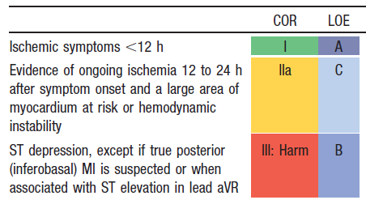
Indications for Fibrinolytic Therapy When There Is a >120-Minute Delay From FMC to Primary PCI

Slide 48
Importance of time to reperfusion in patients undergoing fibrinolysis (National Cardiovascular Data Registry )

Slide 49
Data from 22 trials of fibrinolytic therapy (Boersma E, et al: Early thrombolytic treatment in acute myocardial infarction: Reappraisal of the golden hour. Lancet 348:771, 1996)

Slide 50
Contraindications and Cautions for Fibrinolysis in STEMI
Absolute Contraindications:
Any prior intracranial hemorrhage
Known structural cerebral vascular lesion
Known malignant intracranial neoplasm
Ischemic stroke within 3 months EXCEPT acute ischemic stroke within 4.5 hours
Suspected aortic dissection
Active bleeding or bleeding diathesis (excluding menses)
Significant closed-head or facial trauma within 3 months
For streptokinase- previous treatment within the previous b6 month
A report of the American College of Cardiology Foundation/American Heart Association Task Force on Practice Guidelines. J Am Coll Cardiol 61:e78, 2013.
Note: Age restriction for fibrinolysis has been removed compared with prior guidelines.

Slide 51
Contraindications and Cautions for Fibrinolysis in STEMI
Relative Contraindications:
Severe uncontrolled hypertension on presentation (SBP > 180 or DBP > 110)
Prior ischemic stroke >3 months
Traumatic or prolonged (> 10 mt.) CPR or major surgery (< 3 weeks)
Recent (< 2 to 4 weeks) internal bleeding
Noncompressible vascular punctures
Pregnancy, Active peptic ulcer
Current use of anticoagulants

Slide 52
Comparison of Approved Fibrinolytic Agents
2013 ACCF/AHA guideline for the management of ST-elevation myocardial infarction: J Am Coll Cardiol. 61:e78, 2013)
PARAMETER | STREPTOKINASE | ALTEPLASE | RETEPLASE | TNK t-PA
Dose | 1.5 MU in 30-60 min | Up to 100 mg in 90 min (based on weight) | 10 U +10 U iv boluses (30 min apart) each over 2 min | 30-50 mg based on weight
Bolus administration | No | No | Yes | Yes
Antigenic | Yes | No | No | No
Allergic reactions hypotension most common | Yes | No | No | No
Systemic fibrinogen depletion | Marked | Mild | Moderate | Minimal
90-min patency rates (%) | ≈60- 68 | ≈75-84 | ≈84 | ≈85
TIMI grade 3 flow (%) | 32 | 54 | 60 | 63
Cost per dose (Rs) | 2500 | 39375 (50mg)
Notes:
TNK-†Bolus of 30 mg for weight less than 60 kg, 35 mg for 60 to 69 kg, 40 mg for 70 to 79 kg, 45 mg for 80 to 89 kg, and 50 mg for 90 kg or greater.
alteplase ‡Bolus of 15 mg, infusion of 0.75 mg/kg for 30 minutes (maximum, 50 mg), then 0.5 mg/kg (maximum, 35 mg) over the next 60 minutes; the total dose not to exceed
100 mg.

Slide 53
Adjunctive Antiplatelet Therapy With Fibrinolysis
I
IIa
IIb
III
Aspirin (162- to 325-mg loading dose) and clopidogrel (300-mg loading dose for patients ≤75 years of age, 75-mg dose for patients >75 years of age) should be administered to patients with STEMI who receive fibrinolytic therapy.
A

Slide 54
Adjunctive Antiplatelet Therapy With Fibrinolysis
In patients with STEMI who receive fibrinolytic therapy:
I
IIa
IIb
III
aspirin should be continued indefinitely and
A
I
IIa
IIb
III
clopidogrel (75 mg daily) for at least 14 days
A
I
IIa
IIb
III
and up to 1 year

Slide 55
Adjunctive Antiplatelet Therapy With Fibrinolysis
I
IIa
IIb
III
It is reasonable to use aspirin 81 mg per day in preference to higher maintenance doses after fibrinolytic therapy.
B

Slide 56
Adjunctive Anticoagulant Therapy With Fibrinolysis
I
IIa
IIb
III
Patients with STEMI undergoing reperfusion with fibrinolytic therapy should receive anticoagulant therapy for a minimum of 48 hours, and preferably for the duration of the index hospitalization, up to 8 days or until revascularization if performed. Recommended regimens include:
A
I
IIa
IIb
III
UFH administered as a weight-adjusted intravenous bolus and infusion to obtain an activated partial thromboplastin time of 1.5 to 2.0 times control, for 48 hours or until revascularization;
Enoxaparin administered according to age, weight, and creatinine clearance, given as an intravenous bolus, followed in 15 minutes by subcutaneous injection for the duration of the index hospitalization, up to 8 days or until revascularization; or
Fondaparinux administered with initial intravenous dose, followed in 24 hours by daily subcutaneous injections if the estimated creatinine clearance is greater than 30 mL/min, for the duration of the index hospitalization, up to 8 days or until revascularization.
I
IIa
IIb
III
A
I
IIa
IIb
III
B

Slide 57
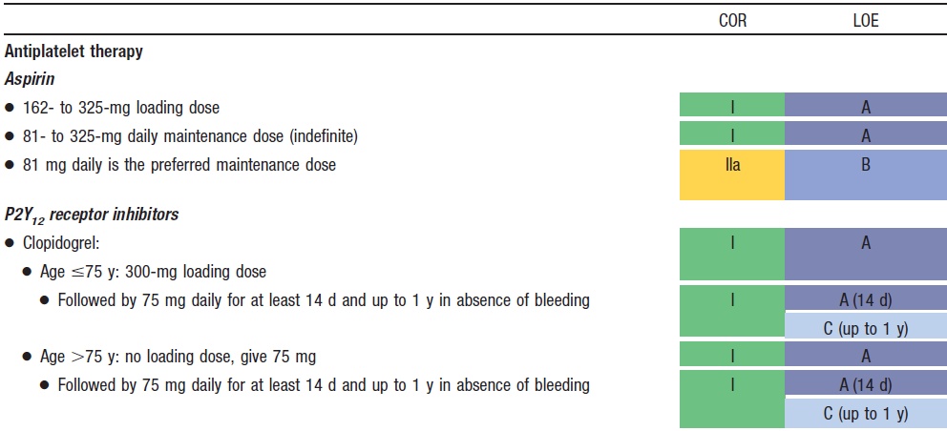
Adjunctive Antithrombotic Therapy to Support Reperfusion With Fibrinolytic Therapy

Slide 58
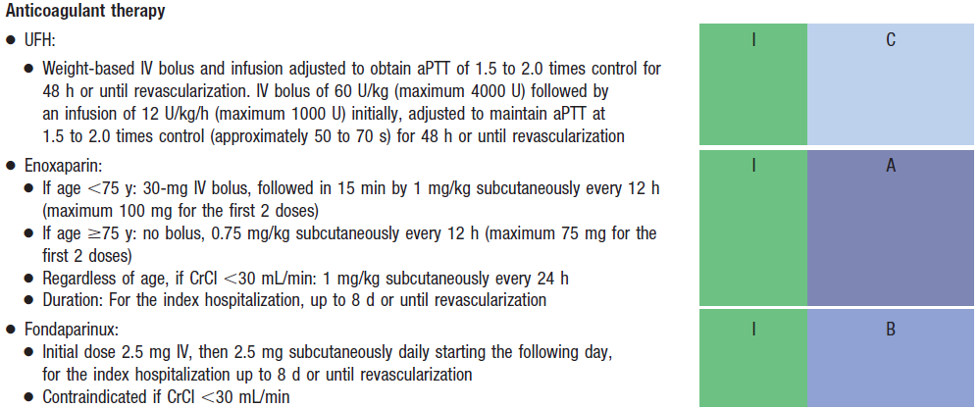
Adjunctive Antithrombotic Therapy to Support Reperfusion With Fibrinolytic Therapy (cont.)

Slide 59
Duration of DAPT in Patients With STEMI Treated With Fibrinolytic Therapy (2016)
COR | LOE | Recommendations
I | A | In patients with STEMI treated with DAPT in conjunction with fibrinolytic therapy, P2Y₁₂ inhibitor therapy (clopidogrel) should be continued for a minimum of 14 days (Level of Evidence: A) and ideally at least 12 months (Level of Evidence: C-EO).
 | C-EO
I | B-NR | In patients treated with DAPT, a daily aspirin dose of 81 mg (range, 75 mg to 100 mg) is recommended.
IIb | A ^{SR} | In patients with STEMI treated with fibrinolytic therapy who have tolerated DAPT without bleeding complication and who are not at high bleeding risk (e.g., prior bleeding on DAPT, coagulopathy, oral anticoagulant use), continuation of DAPT for longer than 12 months may be reasonable.
SR indicates systematic review.
Notes:
2016

Slide 60
Assessment of Reperfusion after fibrinolysis
Noninvasive findings s/o reperfusion include:
Relief of symptoms
Maintenance and restoration of hemodynamic and/or electrical instability
Reduction of ≥ 50% of the initial STE pattern on follow-up ECG 60 to 90 minutes after initiation of therapy.
Class II(A)

Slide 61
Reperfusion at a Non–PCI-Capable Hospital
Transfer of Patients With STEMI to a PCI-Capable Hospital for Coronary Angiography After Fibrinolytic Therapy

Slide 62
Transfer of Patients With STEMI to a PCI-Capable Hospital for Coronary Angiography After Fibrinolytic Therapy
I
IIa
IIb
III
Transfer to a PCI-capable hospital for coronary angiography is reasonable for patients with STEMI who have received fibrinolytic therapy even when hemodynamically stable* and with clinical evidence of successful reperfusion.
Angiography can be performed as soon as logistically feasible at the receiving hospital, and ideally within 24 hours, but should not be performed within the first 2 to 3 hours after administration of fibrinolytic therapy.
B
*Although individual circumstances will vary, clinical stability is defined by the absence of low output, hypotension, persistent tachycardia, apparent shock, high-grade ventricular or symptomatic supraventricular tachyarrhythmias, and spontaneous recurrent ischemia.

Slide 63
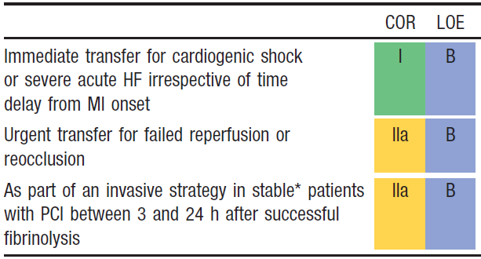
Indications for Transfer for Angiography After Fibrinolytic Therapy
*Although individual circumstances will vary, clinical stability is defined by the
absence of low output, hypotension, persistent tachycardia, apparent shock, high-grade ventricular or symptomatic supraventricular tachyarrhythmias, and spontaneous recurrent ischemia.

Slide 64
Guideline for STEMI
Delayed Invasive Management

Slide 65
Coronary Angiography in Patients Who Initially Were Managed With Fibrinolytic Therapy or Who Did Not Receive Reperfusion
Cardiac catheterization and coronary angiography with intent to perform revascularization should be performed after STEMI in patients with any of the following:
I
IIa
IIb
III
Cardiogenic shock or acute severe HF that develops after initial presentation;
B
I
IIa
IIb
III
Intermediate- or high-risk findings on predischarge noninvasive ischemia testing; or
B
I
IIa
IIb
III
Myocardial ischemia that is spontaneous or provoked by minimal exertion during hospitalization.

Slide 66
Coronary Angiography in Patients Who Initially Were Managed With Fibrinolytic Therapy or Who Did Not Receive Reperfusion
I
IIa
IIb
III
Coronary angiography with intent to perform revascularization is reasonable for patients with evidence of failed reperfusion or reocclusion after fibrinolytic therapy. Angiography can be performed as soon as logistically feasible.
B
I
IIa
IIb
III
Coronary angiography is reasonable before hospital discharge in stable* patients with STEMI after successful fibrinolytic therapy. Angiography can be performed as soon as logistically feasible, and ideally within 24 hours, but should not be performed within the first 2 to 3 hours after administration of fibrinolytic therapy.
B
*Although individual circumstances will vary, clinical stability is defined by the absence of low output, hypotension, persistent tachycardia, apparent shock, high-grade ventricular or symptomatic supraventricular tachyarrhythmias, and spontaneous recurrent ischemia.

Slide 67
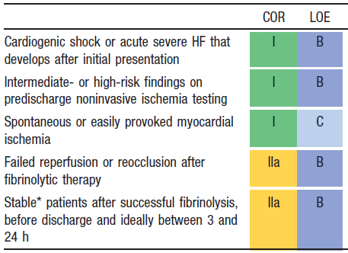
Indications for Coronary Angiography in Patients Who Were Managed With Fibrinolytic Therapy or Who Did Not Receive Reperfusion Therapy
*Although individual circumstances will vary, clinical stability is defined by the absence of low output, hypotension, persistent tachycardia, apparent shock, high-grade ventricular or symptomatic supraventricular tachyarrhythmias, and spontaneous recurrent ischemia.

Slide 68
Late fibrinolysis
LATE and EMERAS trials
Fibrinolysis between 12 and 24 hours
No mortality benefit
Increases risk of cardiac rupture

Slide 69
Delayed Invasive Management
PCI of an Infarct Artery in Patients Who Initially Were Managed With Fibrinolysis or Who Did Not Receive Reperfusion Therapy

Slide 70
PCI of an Infarct Artery in Patients Who Initially Were Managed With Fibrinolysis or Who Did Not Receive Reperfusion Therapy
PCI of an anatomically significant stenosis in the infarct artery should be performed in patients with suitable anatomy and any of the following:
I
IIa
IIb
III
Cardiogenic shock or acute severe HF;
B
I
IIa
IIb
III
Intermediate- or high-risk findings on predischarge noninvasive ischemia testing; or
I
IIa
IIb
III
Myocardial ischemia that is spontaneous or provoked by minimal exertion during hospitalization.

Slide 71
Indications for PCI of an Infarct Artery in Patients Who Were Managed With Fibrinolytic Therapy or Who Did Not Receive Reperfusion Therapy
*Although individual circumstances will vary, clinical stability is defined by the absence of low output, hypotension, persistent tachycardia, apparent shock, high-grade ventricular or symptomatic supraventricular tachyarrhythmias, and spontaneous recurrent ischemia.

Slide 72
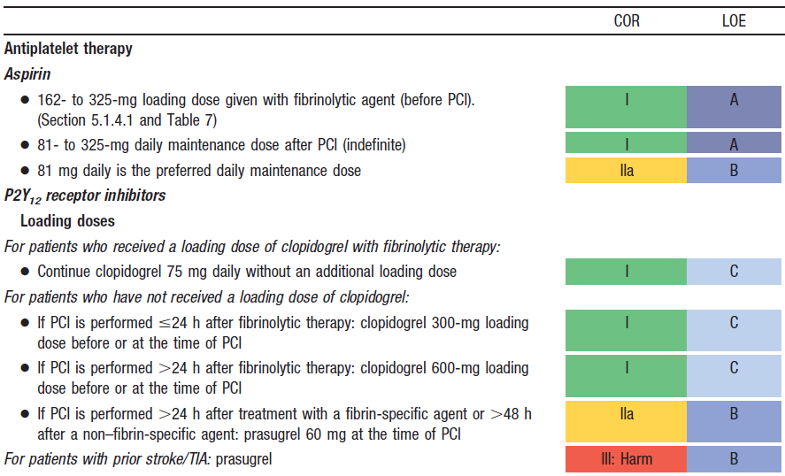
Adjunctive Antithrombotic Therapy to Support PCI After Fibrinolytic Therapy

Slide 73
Adjunctive Antithrombotic Therapy to Support PCI After Fibrinolytic Therapy (cont.)
*Balloon angioplasty without stent placement may be used in selected patients. It might be reasonable to provide P2Y₁₂ inhibitor therapy to patients with STEMI undergoing balloon angioplasty after fibrinolysis alone according to the recommendations listed for BMS. (Level of Evidence: C)

Slide 74
Adjunctive Antithrombotic Therapy to Support PCI After Fibrinolytic Therapy (cont.)
†The recommended ACT with no planned GP IIb/IIIa receptor antagonist treatment is 250–300 s (HemoTec device) or 300–350 s (Hemochron device).

Slide 75
Delayed Invasive Management
PCI of a Noninfarct Artery Before Hospital Discharge

Slide 76
PCI of a Noninfarct Artery Before Hospital Discharge
I
IIa
IIb
III
PCI is indicated in a noninfarct artery at a time separate from primary PCI in patients who have spontaneous symptoms of myocardial ischemia.
I
IIa
IIb
III
PCI is reasonable in a noninfarct artery at a time separate from primary PCI in patients with intermediate- or high-risk findings on noninvasive testing.
B

Slide 77
Culprit Artery – Only Versus Multivessel PCI
COR | LOE | Recommendation
IIb | B-R | PCI of a non infarct artery may be considered in selected patients with STEMI and multi vessel disease who are hemodynamically stable, either at the time of primary PCI or as a planned staged procedure.¹
1. Modified recommendation from 2013 Guideline (changed class from III: Harm to IIb and expanded time frame in which multivessel PCI could be performed).

Slide 78
Coronary Artery Bypass Graft Surgery
CABG in Patients With STEMI

Slide 79
CABG in Patients With STEMI
I
IIa
IIb
III
Urgent CABG is indicated in patients with STEMI and coronary anatomy not amenable to PCI who have ongoing or recurrent ischemia, cardiogenic shock, severe HF, or other high-risk features.
B
I
IIa
IIb
III
CABG is recommended in patients with STEMI at time of operative repair of mechanical defects.
B

Slide 80
CABG in Patients With STEMI
I
IIa
IIb
III
The use of mechanical circulatory support is reasonable in patients with STEMI who are hemodynamically unstable and require urgent CABG.
I
IIa
IIb
III
Emergency CABG within 6 hours of symptom onset may be considered in patients with STEMI who do not have cardiogenic shock and are not candidates for PCI or fibrinolytic therapy.

Slide 81
Timing of Urgent CABG in Patients With STEMI in Relation to Use of Antiplatelet Agents
I
IIa
IIb
III
Aspirin should not be withheld before urgent CABG.
I
IIa
IIb
III
Clopidogrel or ticagrelor should be discontinued at least 24 hours before urgent on-pump CABG, if possible.
B
I
IIa
IIb
III
Short-acting intravenous GP IIb/IIIa receptor antagonists (eptifibatide, tirofiban) should be discontinued at least 2 to 4 hours before urgent CABG.
B

Slide 82
Timing of Urgent CABG in Patients With STEMI in Relation to Use of Antiplatelet Agents
I
IIa
IIb
III
Abciximab should be discontinued at least 12 hours before urgent CABG.
B
I
IIa
IIb
III
Urgent off-pump CABG within 24 hours of clopidogrel or ticagrelor administration might be considered, especially if the benefits of prompt revascularization outweigh the risks of bleeding.
B
I
IIa
IIb
III
Urgent CABG within 5 days of clopidogrel or ticagrelor administration or within 7 days of prasugrel administration might be considered, especially if the benefits of prompt revascularization outweigh the risks of bleeding.

Slide 83
Routine Medical Therapies
Beta Blockers

Slide 84
Beta-Blockers
Relieve ischemic pain, reduce need for analgesics, reduce infarct size and life-threatening arrhythmias
Contra indications:
signs of heart failure
evidence of a low output state
increased risk for cardiogenic shock
other relative contraindications (PR interval > 0.24 S. 2nd or 3rd degree AV block, or reactive airway disease)

Slide 85
Beta-Blockers

Slide 86
Beta Blockers
I
IIa
IIb
III
Oral beta blockers should be initiated in the first 24 hours in patients with STEMI who do not have any of the following: signs of HF, evidence of a low output state, increased risk for cardiogenic shock,* or other contraindications to use of oral beta blockers (PR interval >0.24 seconds, second- or third-degree heart block, active asthma, or reactive airways disease).
B
I
IIa
IIb
III
Beta blockers should be continued during and after hospitalization for all patients with STEMI and with no contraindications to their use.
B
*Risk factors for cardiogenic shock (the greater the number of risk factors present, the higher the risk of developing cardiogenic shock) are age >70 years, systolic BP <120 mm Hg, sinus tachycardia >110 bpm or heart rate <60 bpm, and increased time since onset of symptoms of STEMI.

Slide 87
Beta Blockers
I
IIa
IIb
III
Patients with initial contraindications to the use of beta blockers in the first 24 hours after STEMI should be reevaluated to determine their subsequent eligibility.
I
IIa
IIb
III
It is reasonable to administer intravenous beta blockers at the time of presentation to patients with STEMI and no contraindications to their use who are hypertensive or have ongoing ischemia.
B

Slide 88
Renin-Angiotensin-Aldosterone System Inhibitors
I
IIa
IIb
III
An ACE inhibitor should be administered within the first 24 hours to all patients with STEMI with anterior location, HF, or EF less than or equal to 0.40, unless contraindicated.
A
I
IIa
IIb
III
An ARB should be given to patients with STEMI who have indications for but are intolerant of ACE inhibitors.
B

Slide 89
Renin-Angiotensin-Aldosterone System Inhibitors
I
IIa
IIb
III
An aldosterone antagonist should be given to patients with STEMI and no contraindications who are already receiving an ACE inhibitor and beta blocker and who have an EF less than or equal to 0.40 and either symptomatic HF or diabetes mellitus.
B
I
IIa
IIb
III
ACE inhibitors are reasonable for all patients with STEMI and no contraindications to their use.
A

Slide 90
ACE inhibitors on mortality after MI- from long-term trials.

Slide 91
ACE inhibitors on mortality after MI- from short-term trials.

Slide 92
Angiotensin II receptor blockers VALIANT TRIAL-Mortality

Slide 93
Angiotensin II receptor blockers VALIANT TRIAL-MACE

Slide 94
Aldosterone blockade
EPHESUS trial: Eplerenone, 25 mg/day titrated to 50 mg/day for high-risk patients following STEMI (EF ≤40%, clinical HF, DM)
Mean follow-up 16 months, there was a 15% reduction in the RR of mortality

Slide 95
Calcium Channel Antagonists
Immediate-release preparation of nifedipine increased risk of in-hospital mortality
Verapamil & diltiazem can be given for relief of ongoing ischemia or slowing of a rapid ventricular response in AF in patients with contraindication to beta blockers.
INTERCEPT trial compared 300 mg of diltiazem with placebo and Diltiazem did not reduce cardiac death, nonfatal re infarction, during a 6-month follow-up

Slide 96
Intensive Glucose Control in STEMI
It is reasonable to use an insulin based regimen to achieve and maintain glucose levels less than 180 mg/dl while avoiding hypoglycemia for patients with STEMI with either a complicated or uncomplicated course
Class IIa(B)

Slide 97
Lipid Management
I
IIa
IIb
III
High-intensity statin therapy should be initiated or continued in all patients with STEMI and no contraindications to its use.
B
I
IIa
IIb
III
It is reasonable to obtain a fasting lipid profile in patients with STEMI, preferably within 24 hours of presentation.

Slide 98
Complications After STEMI
Treatment of Cardiogenic Shock

Slide 99
Treatment of Cardiogenic Shock
I
IIa
IIb
III
Emergency revascularization with either PCI or CABG is recommended in suitable patients with cardiogenic shock due to pump failure after STEMI irrespective of the time delay from MI onset.
B
I
IIa
IIb
III
In the absence of contraindications, fibrinolytic therapy should be administered to patients with STEMI and cardiogenic shock who are unsuitable candidates for either PCI or CABG.
B

Slide 100
Treatment of Cardiogenic Shock
I
IIa
IIb
III
The use of intra-aortic balloon pump counterpulsation can be useful for patients with cardiogenic shock after STEMI who do not quickly stabilize with pharmacological.
B
I
IIa
IIb
III
Alternative LV assist devices for circulatory support may be considered in patients with refractory cardiogenic shock.

Slide 101
Complications After STEMI
Electrical Complications During the Hospital Phase of STEMI

Slide 102
Implantable Cardioverter-Defibrillator Therapy Before Discharge
I
IIa
IIb
III
ICD therapy is indicated before discharge in patients who develop sustained VT/VF more than 48 hours after STEMI, provided the arrhythmia is not due to transient or reversible ischemia, reinfarction, or metabolic abnormalities.
B

Slide 103
Complications After STEMI
Bradycardia, AV Block, and Intraventricular Conduction Defects

Slide 104
Pacing in STEMI
I
IIa
IIb
III
Temporary pacing is indicated for symptomatic bradyarrhythmias unresponsive to medical treatment.

Slide 105
Complications After STEMI
Management of Pericarditis After STEMI

Slide 106
Pericarditis
first day and as late as 6 weeks after STEMI
Radiation of the pain to either trapezius ridge.
Treatment consists of aspirin doses of 650 mg orally every 4 to 6 hours may be necessary.
NSAIDs and steroids should be avoided

Slide 107
Management of Pericarditis After STEMI
I
IIa
IIb
III
Aspirin is recommended for treatment of pericarditis after STEMI.
B
I
IIa
IIb
III
Administration of acetaminophen, colchicine, or narcotic analgesics may be reasonable if aspirin, even in higher doses, is not effective.
I
IIa
IIb
III
Glucocorticoids and nonsteroidal antiinflammatory drugs are potentially harmful for treatment of pericarditis after STEMI.
B
Harm

Slide 108
Complications After STEMI
Thromboembolic and Bleeding Complications

Slide 109
Anticoagulation
I
IIa
IIb
III
Anticoagulant therapy with a vitamin K antagonist should be provided to patients with STEMI and atrial fibrillation with CHADS2* score greater than or equal to 2, mechanical heart valves, venous thromboembolism, or hypercoagulable disorder.
I
IIa
IIb
III
The duration of triple-antithrombotic therapy with a vitamin K antagonist, aspirin, and a P2Y₁₂ receptor inhibitor should be minimized to the extent possible to limit the risk of bleeding.†
*CHADS2 (Congestive heart failure, Hypertension, Age ≥75 years, Diabetes mellitus, previous Stroke/transient ischemic attack (doubled risk weight)) score.
†Individual circumstances will vary and depend on the indications for triple therapy and the type of stent placed during PCI.
After this initial treatment period, consider therapy with a vitamin K antagonist plus a single antiplatelet agent.
For patients treated with fibrinolysis, consider triple therapy for 14 days, followed by a vitamin K antagonist plus a single antiplatelet agent.

Slide 110
Anticoagulation
I
IIa
IIb
III
Anticoagulant therapy with a vitamin K antagonist is reasonable for patients with STEMI and asymptomatic LV mural thrombi.
I
IIa
IIb
III
Anticoagulant therapy may be considered for patients with STEMI and anterior-apical akinesis or dyskinesis.
I
IIa
IIb
III
Targeting vitamin K antagonist therapy to a lower international normalized ratio (e.g., 2.0 to 2.5) might be considered in patients with STEMI who are receiving DAPT.

Slide 111
Guideline for STEMI
Risk Assessment After STEMI

Slide 112
Late risk stratification
Late risk stratification is performed before or sometimes after discharge (generally 3 to 7 days after the myocardial infarction and can be used to consider early discharge in patients with a low risk of complications and to help patients understand their long-term prognosis
The main components are measurement of the left ventricular ejection fraction and stress testing

Slide 113
Risk Assessment After STEMI
Use of Noninvasive Testing for Ischemia Before Discharge

Slide 114
Use of Noninvasive Testing for Ischemia Before Discharge
I
IIa
IIb
III
Noninvasive testing for ischemia should be performed before discharge to assess the presence and extent of inducible ischemia in patients with STEMI who have not had coronary angiography and do not have high-risk clinical features for which coronary angiography would be warranted.
B
I
IIa
IIb
III
Noninvasive testing for ischemia might be considered before discharge to evaluate the functional significance of a noninfarct artery stenosis previously identified at angiography.
I
IIa
IIb
III
Noninvasive testing for ischemia might be considered before discharge to guide the postdischarge exercise prescription.

Slide 115
Post MI Management: Pre-discharge TMT
Sub maximal protocol
Target workload =5 METS, 70 % MPHR or symptom limited
Predictors of poor outcome
Ischemic ST depression > 1 mm is inconsistent predictor of mortality
poor exercise tolerance < 3 minutes doubles one year mortality ( 7% to14%)
Inability to exercise or contra-indication to TMT identifies High Risk patient.

Slide 116
Assessment of LV Function
I
IIa
IIb
III
LVEF should be measured in all patients with STEMI.
Notes:
In the absence of a specific indication (eg, heart failure or suspected mechanical complication), the LVEF is usually measured before discharge
However it can be misleading since improvement in LVEF, beginning within three days and largely complete by 14 days, is common in patients who either reperfuse spontaneously or undergo percutaneous coronary intervention (PCI).
This is believed to reflect recovery from myocardial stunning
Added advantage of detecting other prognostic factors like diastolic dysfunction, concurrent RV dysfunction, increased left atrial volume, mitral regurgitation, and a high wall motion score index

Slide 117
Assessment of Risk for SCD
I
IIa
IIb
III
Patients with an initially reduced LVEF who are possible candidates for ICD therapy should undergo reevaluation of LVEF 40 or more days after discharge.
B

Slide 118
Posthospitalization Plan of Care
I
IIa
IIb
III
Posthospital systems of care designed to prevent hospital readmissions should be used to facilitate the transition to effective, coordinated outpatient care for all patients with STEMI.
B
I
IIa
IIb
III
Exercise-based cardiac rehabilitation/secondary prevention programs are recommended for patients with STEMI.
B

Slide 119
LIFE-STYLE MODIFICATION
Smoking Goal: Complete Cessation
With in 2yrs risk of nonfatal MI falls to normal
Blood pressure control:
Goal: < 140/90 mm Hg or <130/80 mm Hg if chronic kidney disease or diabetes
Physical activity:
Minimum goal: 30 minutes 3 to 4 days per week; Optimal daily.
Weight management:
Goal: BMI 18.5 to 24.9 kg/m2
Waist circumference: Women < 35 in. Men: < 40 in.

Slide 120
Secondary Prevention and Long Term Management
Diabetes management:
Goal: HbA1c < 7%
Lipid management: Primary goal: LDL-C <70mg%
Start dietary therapy in all patients (< 7% of total calories as saturated fat and < 200 mg/d cholesterol). Promote physical activity and weight management. Encourage increased consumption of omega-3 fatty acids.
Assess fasting lipid profile in all patients, preferably within 24 hours of STEMI.

Slide 121
Secondary Prevention and Long Term Management
Psychosocial status of the patient should be evaluated, including inquiries regarding symptoms of depression, anxiety, or sleep disorders and the social support environment. Class I (C)
Treatment with cognitive-behavioral therapy and selective serotonin reuptake inhibitors can be useful for STEMI patients with depression that occurs in the year after hospital discharge. Class IIa (A)

Slide 122
Potential Cumulative Impact of 2° Prevention Treatments
( Yusuf, S. Two decades of progress in preventing vascular disease. Lancet 2002; 360: 2-3).
 | RRR | 2yr Event Rate
None |  | 8%
ASA | 25% | 6%
β -Blockers | 25% | 4.5%
Lipid lowering | 30% | 3.0%
ACE-inhibitors | 25% | 2.3%
Cumulative relative risk reduction if all four drugs are used is about 75%

Slide 123
Thank You

